Slide 1
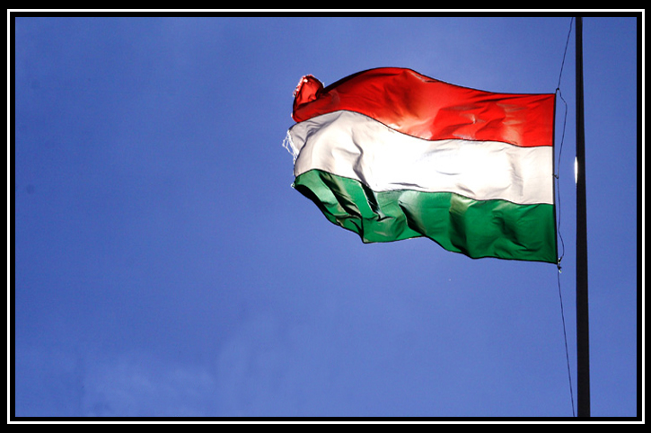
Migration

Slide 2
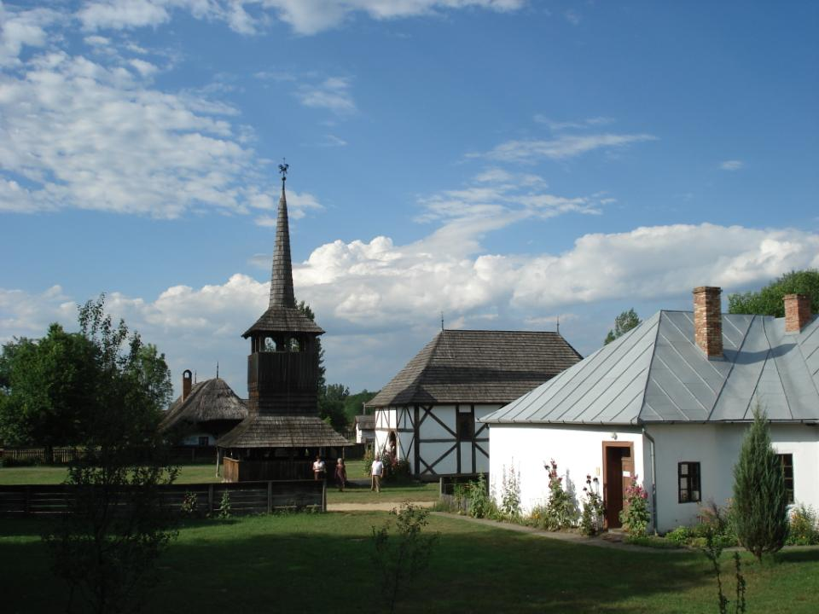
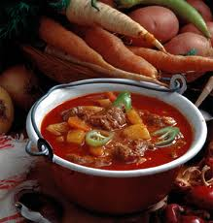
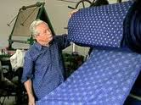
Tirpak
Established in 1970
The biggest regional open-air museum
Szabolcs-Szatmár-Bereg County
Ethnic units: Szatmár, Rétköz, Nyírség, Mezőség, Bereg, Tirpák
Cooking of Hungary
Folk music is played
Workshops, school
Exhibition

Slide 3
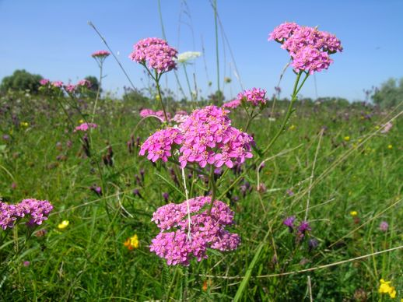
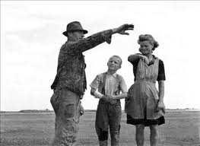
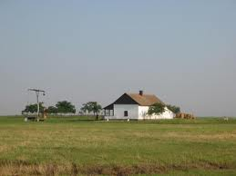
Small farms- „Bokortanya”
Tirpak people
Special farms types
Old, bigger space
Farming, agriculture, animal husbandry
Given the name by the most ancient family
Benkőbokor, Sulyánbokor, Vajdabokor, Rókabokor, Salamonbokor

Slide 4
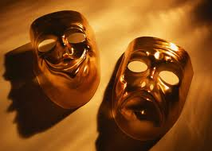
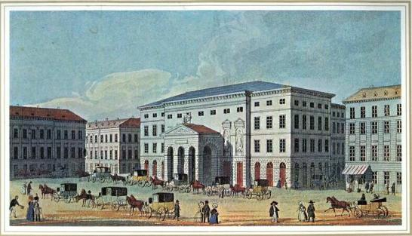
German
Opened by Beethoven’s work of art
Hindered the developing of Hungarian language (German)
Conductor Ferenc Erkel (1833-1838)
German Theatre of Pest
Since 1812
Styled in classicist
Played musical and prose plays

Slide 5
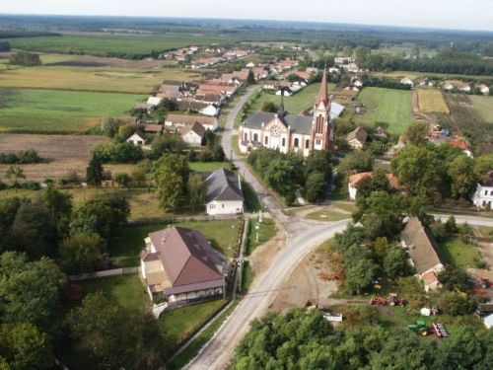
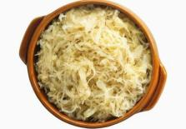
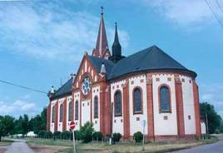
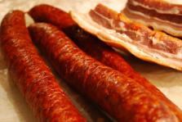
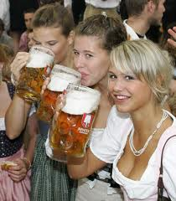
German
Kraut tradition
Food: sauerkraut
Sausages, bacon
Church of Vállaj
Catholic Church
Eclectic style

Slide 6
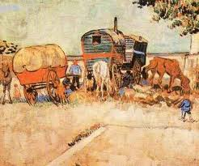
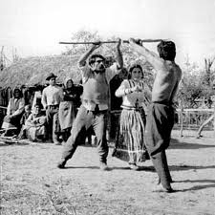
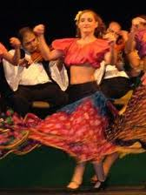
Gypsy
Gypsy dance – „botoló”
With guns and sticks
Like a fighting
Continuously changing (botoló dance)

Slide 7
Gypsy Shymphony Orchestra
The world’s largest gypsy Orchestra
Consists of 60 violins, 9 violas,
6 cellos, 10 double basses,
9 clarinets, 6 cimbaloms
Traditional dresses
Plays by heart, without score
Quick changes of rhythm
Founded in 1985 – Sándor Járóka

Slide 8
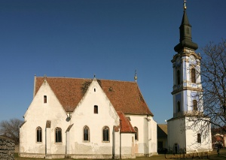
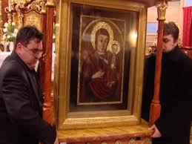
Serbian
Miracle picture
Serbian people loyal to their religion
From 15th century
Ráckeve- Church of Nagyboldogasszony
Gothical orthodox church

Slide 9
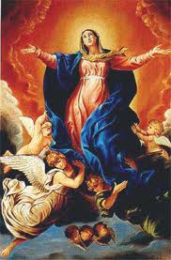
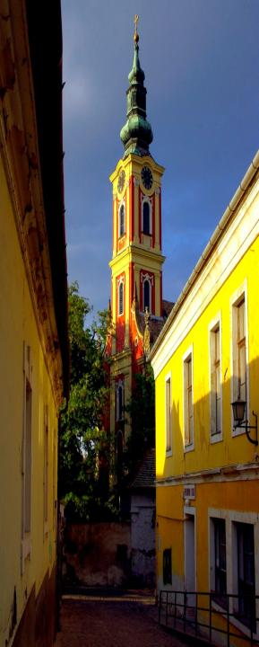
Serbian
Serbian Church of Szentendre
Baroque and rococo style
Saint of Patron:
Gyümölcsoltó Boldogasszony
From 1752

Slide 10
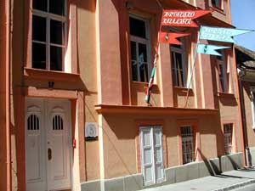
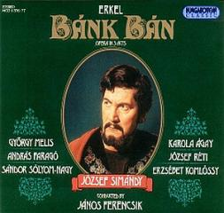
Croatian
in Pécs
Croatian Theatre in Pécs
From 1895
Croatian and Hungarian plays
Ferenc Erkel, Bánk Bán was put on stage

Slide 11
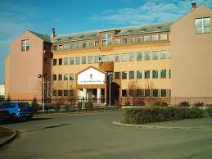
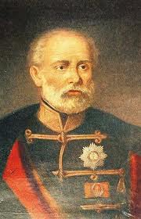
Polish
József Bem
Polish-Hungarian connection
from the „Settlement of the Magyars in Hungary”

Slide 12
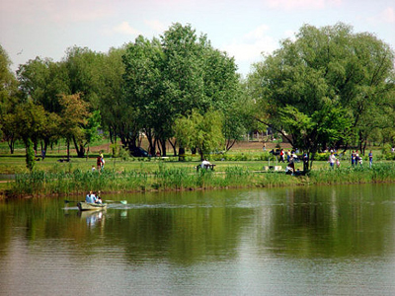
Thank you for your attention!

